Slide 1
Genetic association between genetic variation and flowering traits of Miscanthus grown at Alabama
Yongli Zhao
Ph.D, Biology, Tuskegee University
M.S. Probability and Statistics, Auburn University

Slide 2
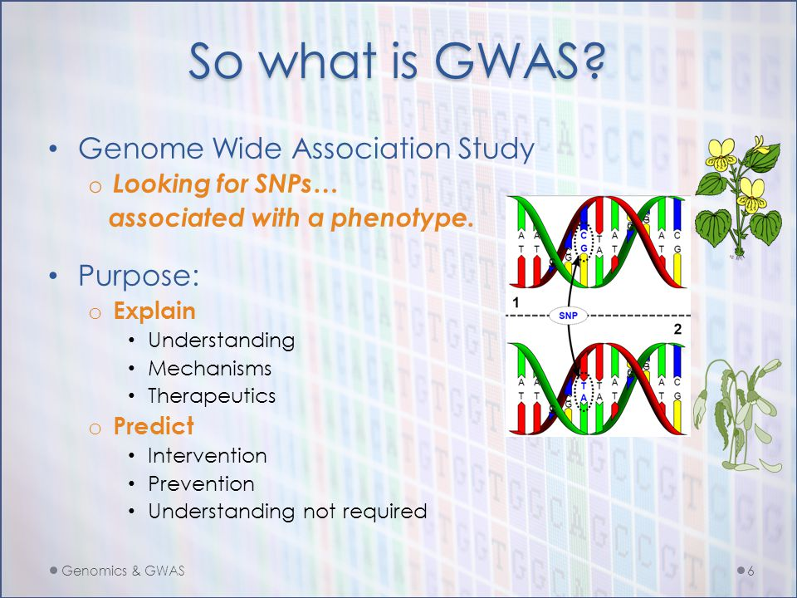
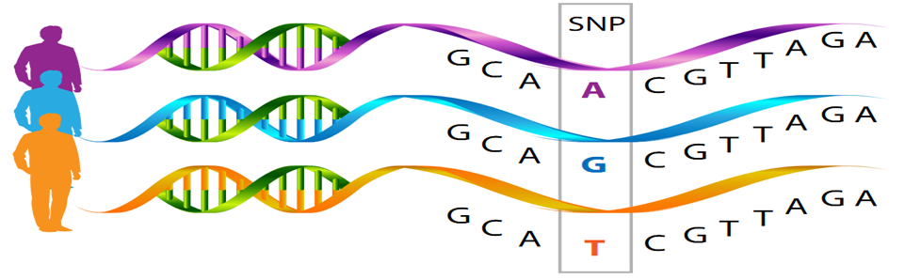
Project
Goal: Finding the SNPs associated with flowering time trait.
GWAS: Genome-wide association study
SNP: Single Nucleotide Polymorphism
Searching
Associated
Trait

Slide 3
Data
Genotype data: SNPs
Names of individuals
ID of the SNPs
Homozygotes are denoted by “0” and “2”.
Heterozygotes are denoted by “1”.
Imputed values
Genotype: ~46177 imputed SNPs developed by Dr. Lindsay Clark in UIUC.
https://raw.githubusercontent.com/yzhao4651/Miscanthus/master/data/subgenomrMLMMflo.csv

Slide 4
Data
Phenotype data: flowering time traits
Missing value
N: 169 individuals for two years data
P: 4 variables
fprind: flowering time labeled with day.
fprinW: flowering time labeled with week.
fprinGW: flowering time labeled with week group
fprinM: flowering time labeled with Month.
https://github.com/yzhao4651/Miscanthus/blob/master/data/alltraits.csv

Slide 5
Experimental Approach
Data analysis: GWAS analysis
Multivariate methods (Multiple loci analysis)
FarmCPU: k model (Liu et al. 2016)
https://github.com/yzhao4651/Miscanthus/blob/master/5%20Mis-imputedSNP-data%20incubator.R
https://github.com/yzhao4651/Miscanthus/blob/master/6%20GAPIT-and-FarmCPU-data%20incubator.R
https://github.com/yzhao4651/Miscanthus/blob/master/11%20FLOPC-data%20incubator.R

Slide 6
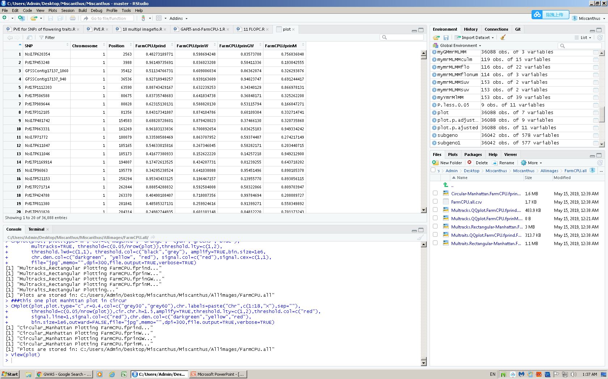
Result
Results
N: 36088 observations: each one is the SNPs name.
P: 7 variables.
SNP: the gene marker
Chromosome: the location of the gene marker
Position: the location in each Chromosome
FarmCPU.fprind: the P. Value from FarmCPU method with flowering time labeled with day
FarmCPU.fprinW: the P. Value from FarmCPU method with flowering time labeled with week
FarmCPU.fprinGW: the P. Value from FarmCPU method with flowering time labeled with week group
FarmCPU.fprinM: the P. Value from FarmCPU method with flowering time labeled with Month

Slide 7
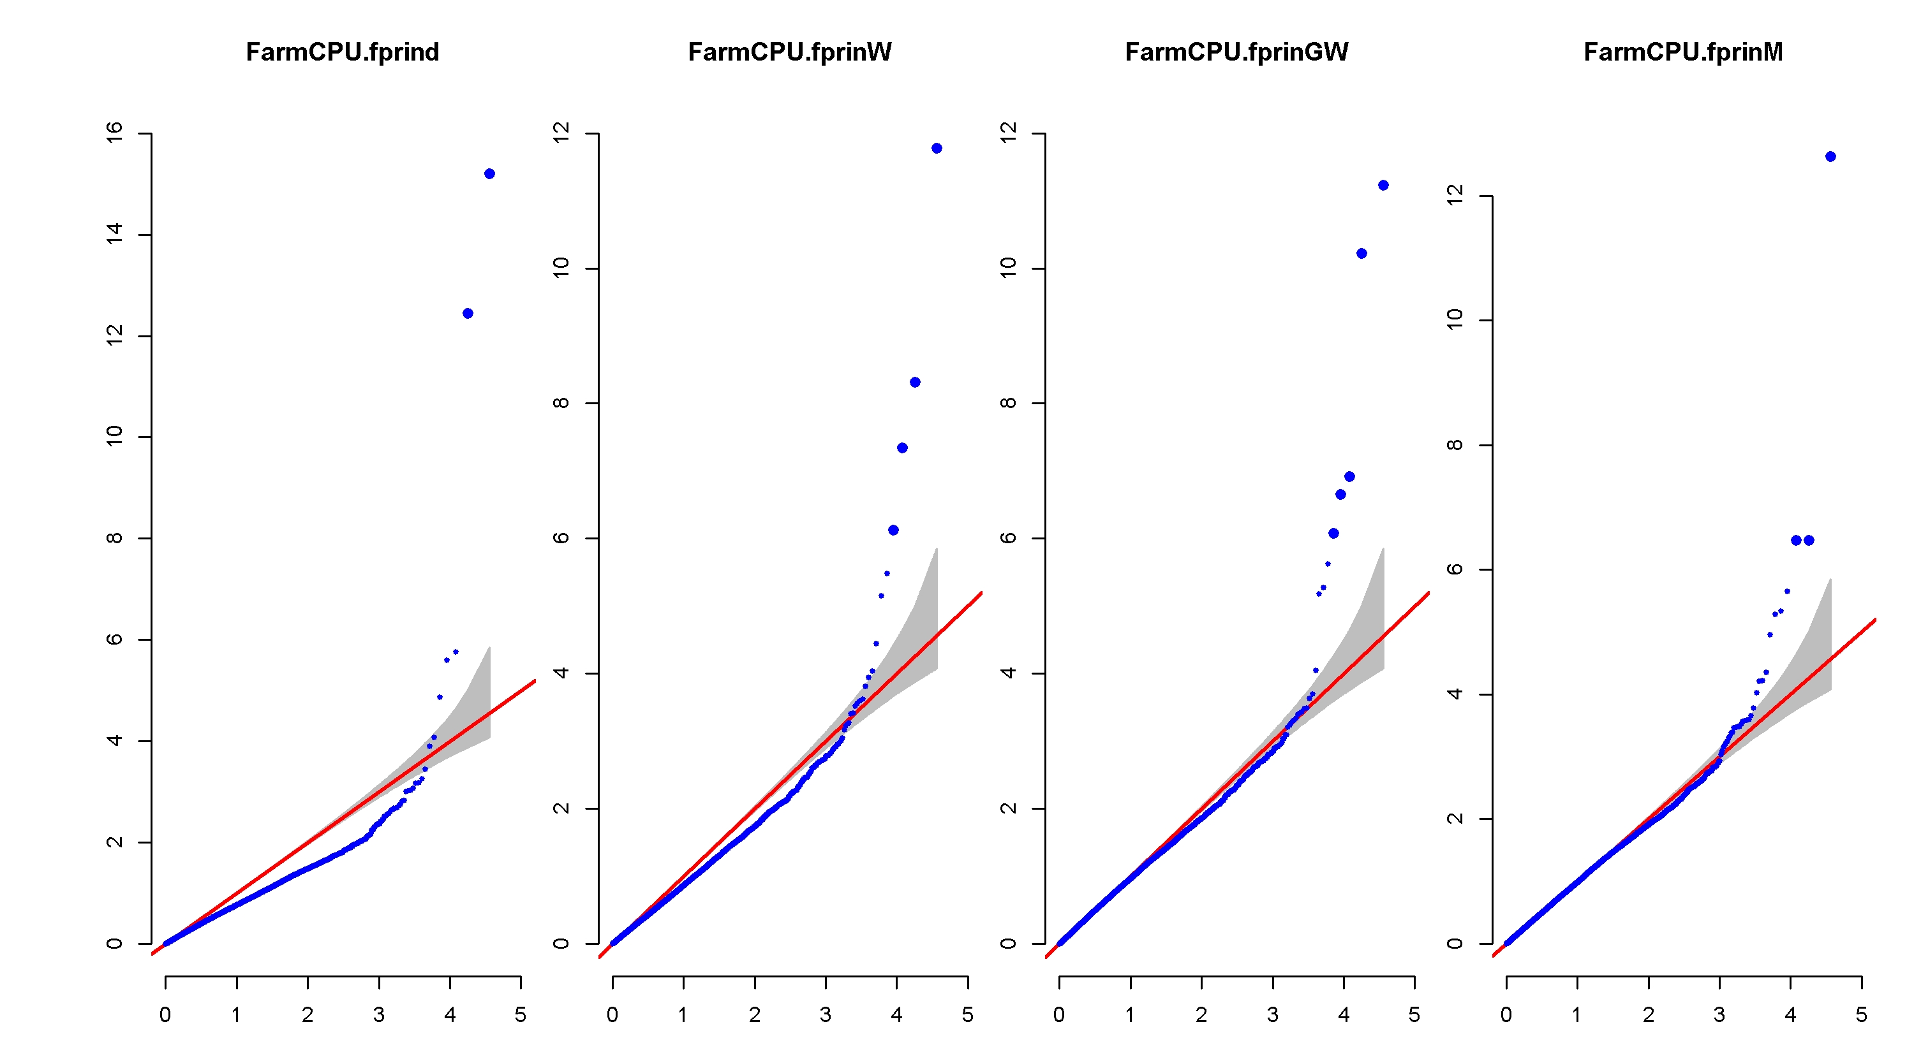
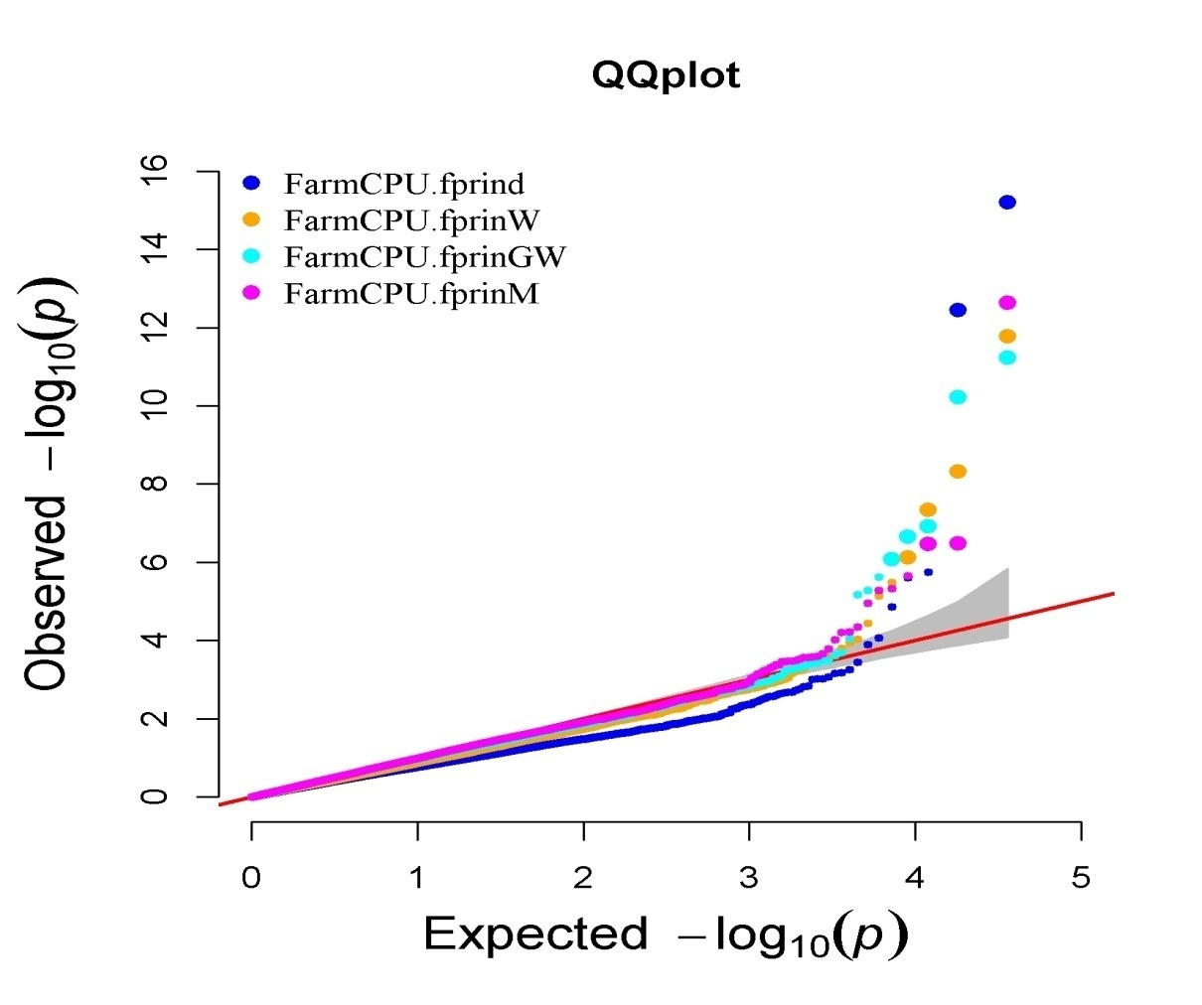
Result
The quantile-quantile (QQ) –plot:
a useful tool for assessing how well the model used in GWAS accounts for population structure and cryptic relatedness.
Y: -log10( P-values from the models)
X: -log10(expected p-value of H0)
H0: no association
The majority of the points should lie on the diagonal line.
The SNPs on the upper right section of the graph deviate from the diagonal. These SNPs are most likely associated with the trait under study.
Deviations from the diagonal suggest the presence of spurious associations due to population structure and cryptic relatedness that the GWAS model does not sufficiently account for these spurious associations.
https://github.com/yzhao4651/Miscanthus/blob/master/Allimages/FarmCPU.all/Multracks.QQplot.FarmCPU.fprind.FarmCPU.fprinW.FarmCPU.fprinGW.FarmCPU.fprinM.jpg

Slide 8
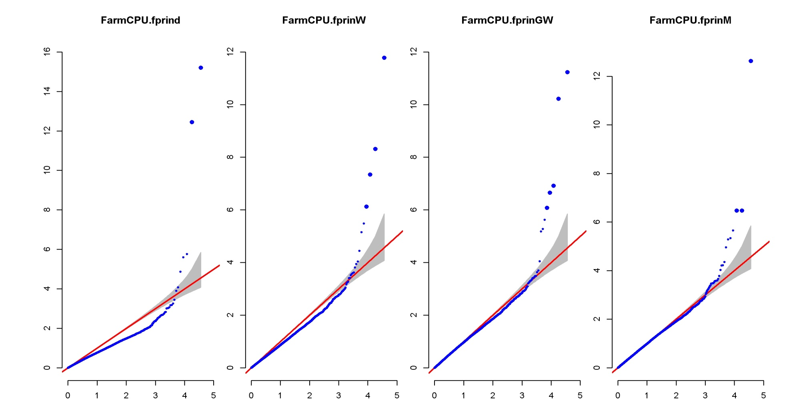
Result (QQ-plot)
https://github.com/yzhao4651/Miscanthus/blob/master/Allimages/FarmCPU.all/Multracks.QQplot.FarmCPU.fprind.FarmCPU.fprinW.FarmCPU.fprinGW.FarmCPU.fprinM.jpg

Slide 9
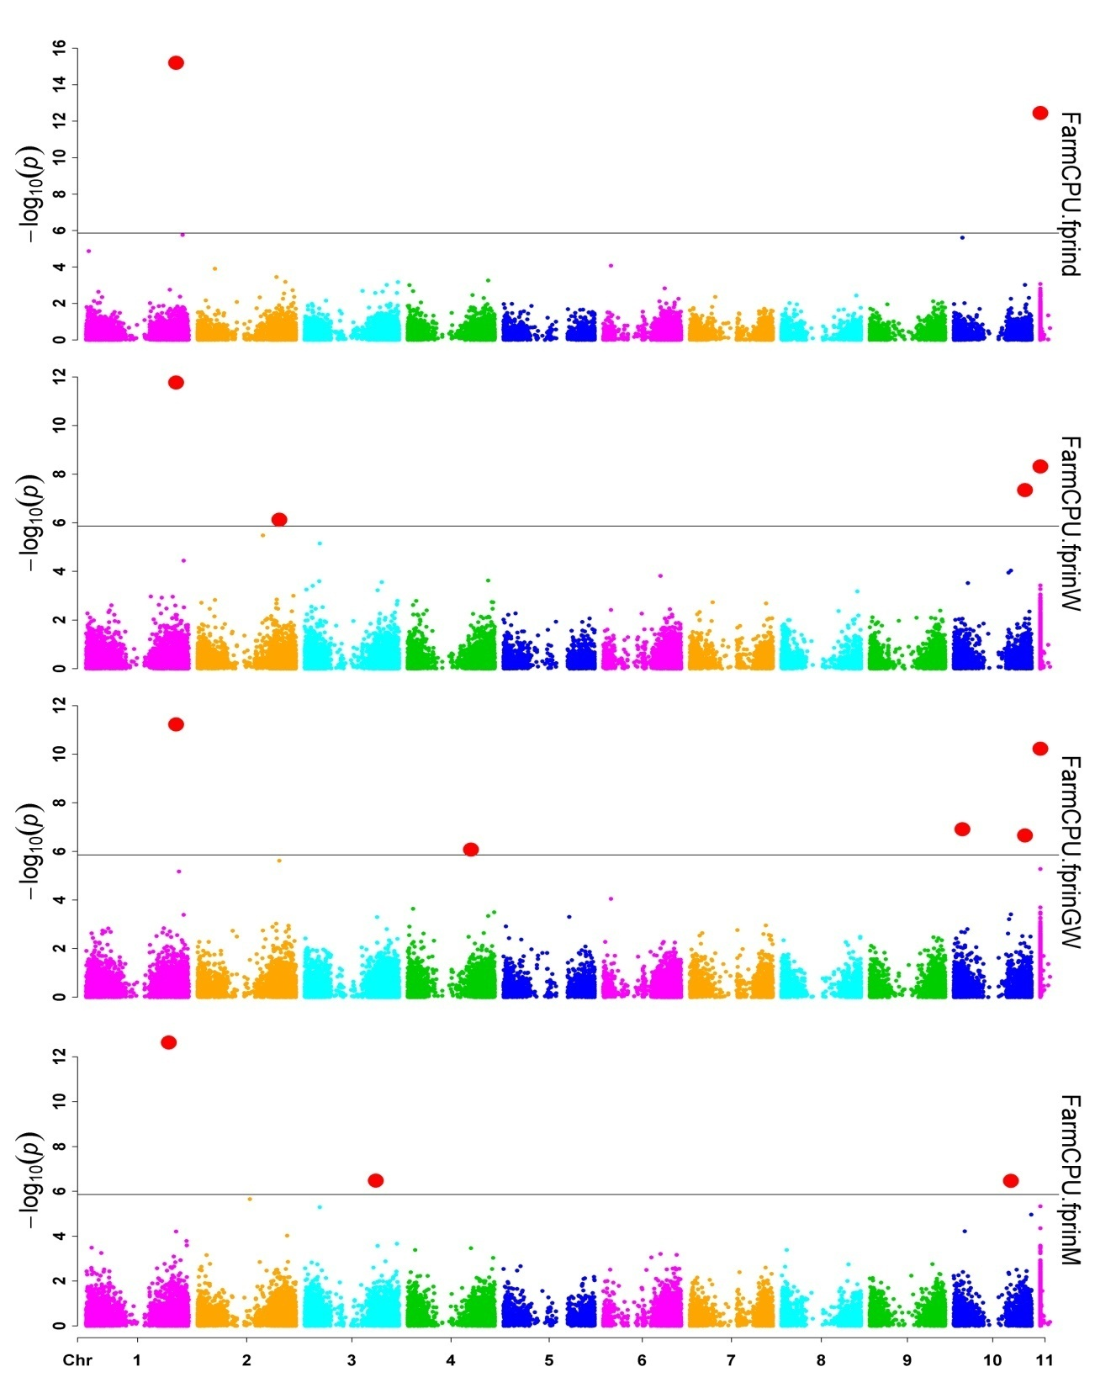
Project
Results (Manhattan plot)
A scatter plot that summarizes GWAS results
X-axis: the genomic position of the SNPs in the genome.
Y-axis: -log 10(P-values)
SNPs with stronger associations with the trait will have a larger
Y-coordinate value.
(Red dots)
https://github.com/yzhao4651/Miscanthus/blob/master/Allimages/FarmCPU.all/Multracks.Rectangular-Manhattan.FarmCPU.fprind.FarmCPU.fprinW.FarmCPU.fprinGW.FarmCPU.fprinM.jpg

Slide 10
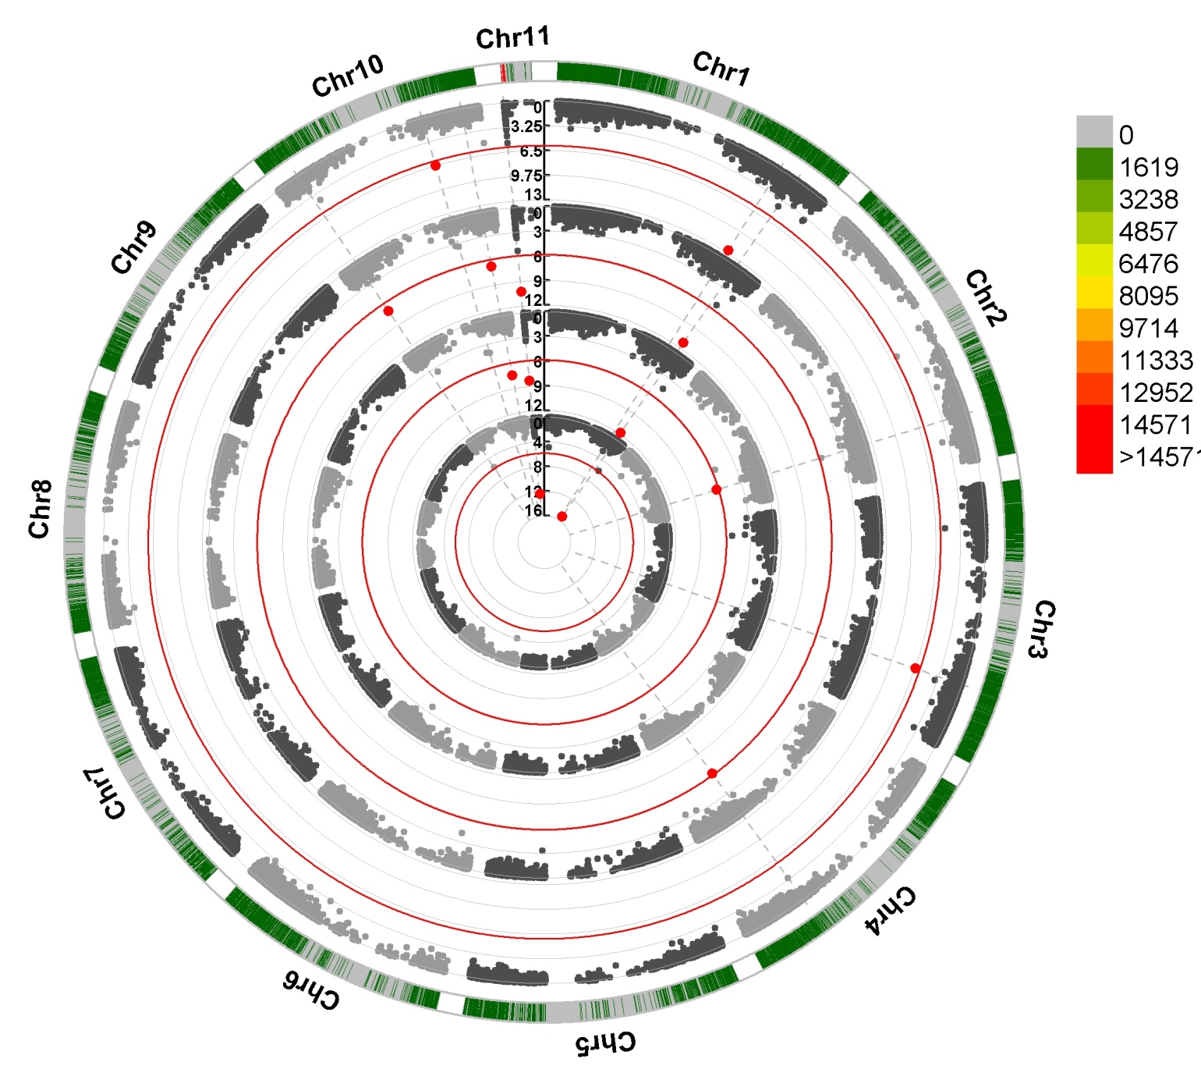
Result
https://github.com/yzhao4651/Miscanthus/blob/master/Allimages/FarmCPU.all/Circular-Manhattan.FarmCPU.fprind.FarmCPU.fprinW.FarmCPU.fprinGW.FarmCPU.fprinM.jpg

Slide 11
Expectation: from Data incubator
1) labeling each of SNPs in the QQ-plots and Manhattan plots
2) Which statistics can be used to the best measure method for flowering time traits.
https://github.com/yzhao4651/Miscanthus/blob/master/11%20FLOPC-data%20incubator.R
https://github.com/yzhao4651/Miscanthus/blob/master/Allimages/FarmCPU.p.less.0.05.csv

Slide 12
Reference
Liu X, Huang M, Fan B, Buckler ES, Zhang Z (2016) Iterative Usage of Fixed and Random Effect Models for Powerful and Efficient Genome-Wide Association Studies. PloS Genet 12(2): e1005767. doi:10.1371/journal.pgen.1005767
https://github.com/YinLiLin/R-CMplot

